Slide 1

Design and Implementation of a Wireless Pulse Monitoring System
Presented By:
Aneri Desai Prateeksha Ranjan Sahil Kakdiya Vaibhav Gajera

Slide 2
OBJECTIVE
Capture pulse signals from a PPG sensor.
Transmit the pulse data over Bluetooth.
Display pulse data and health metrics on a GUI at the receiver end.

Slide 3
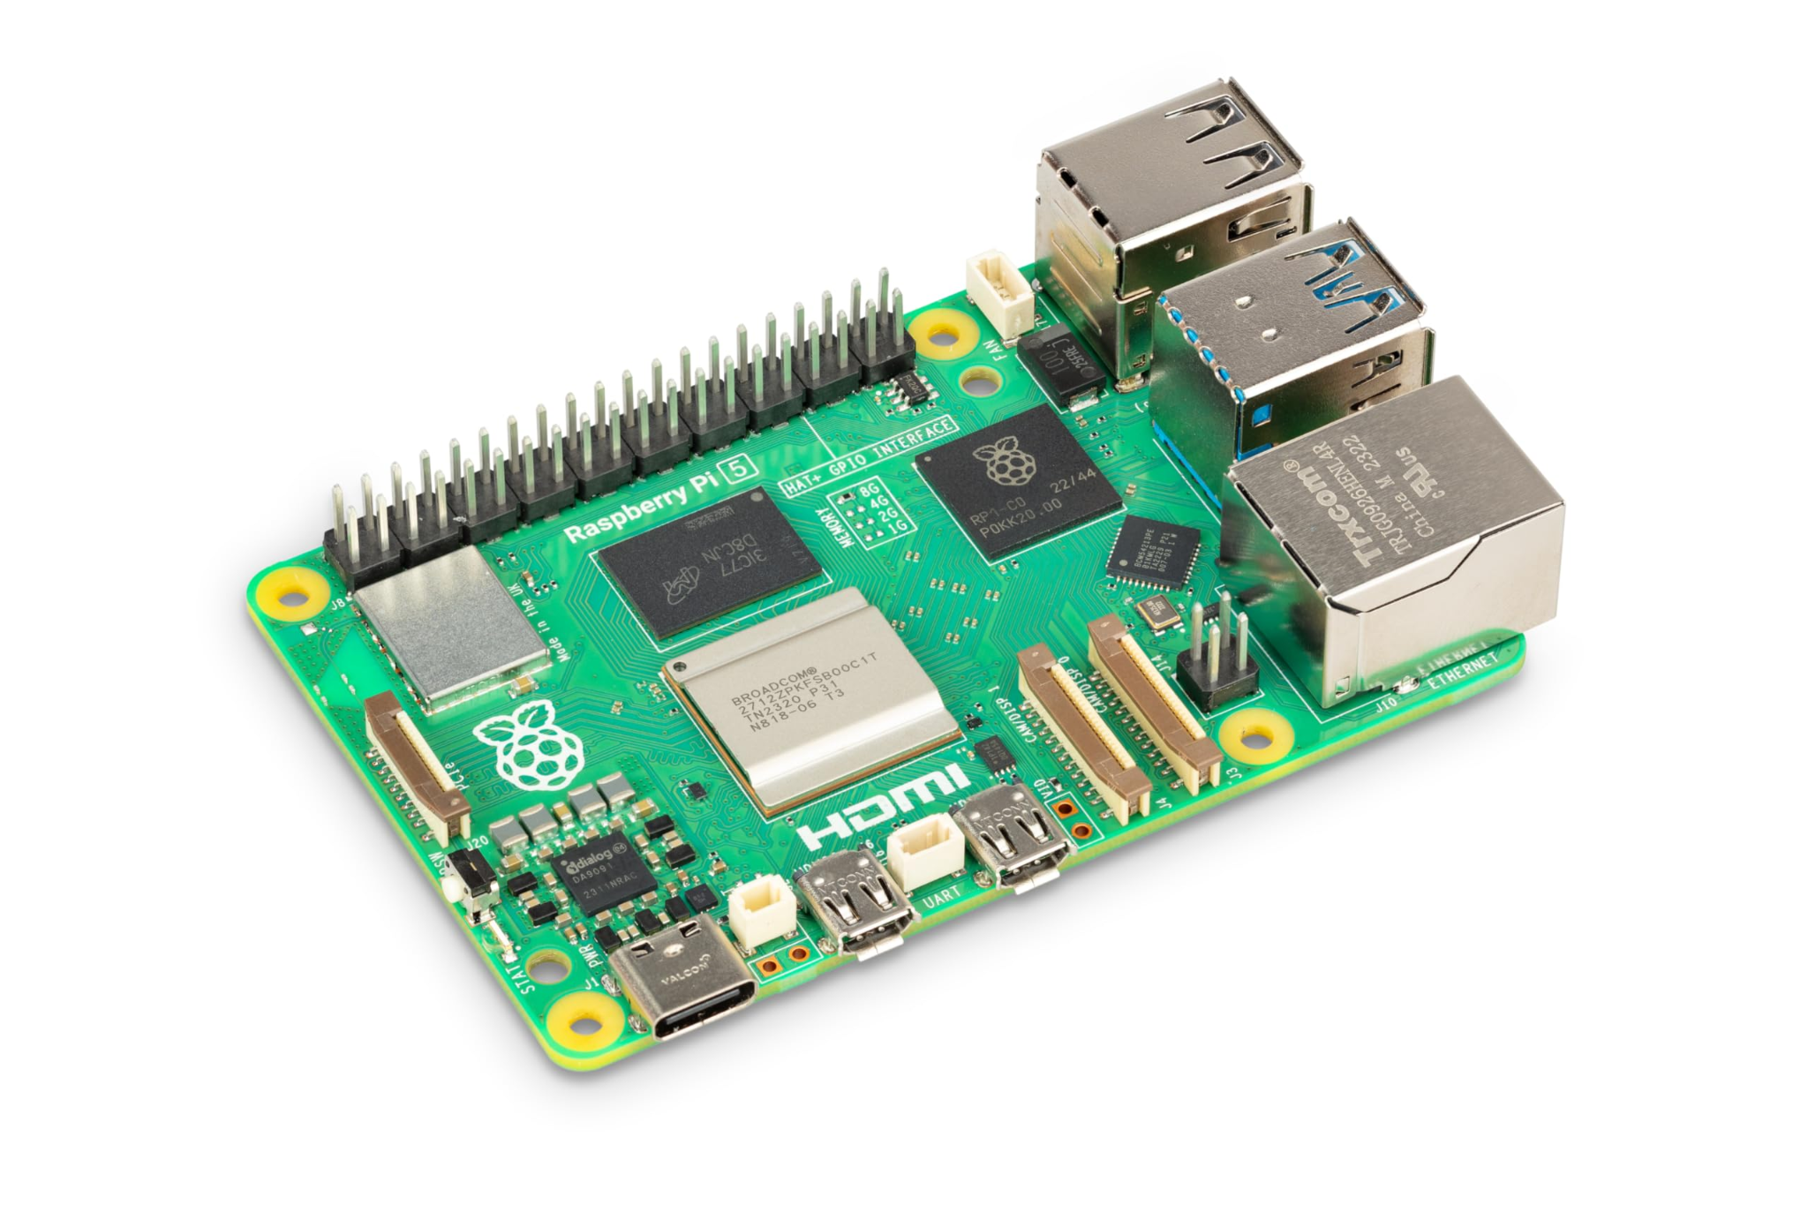
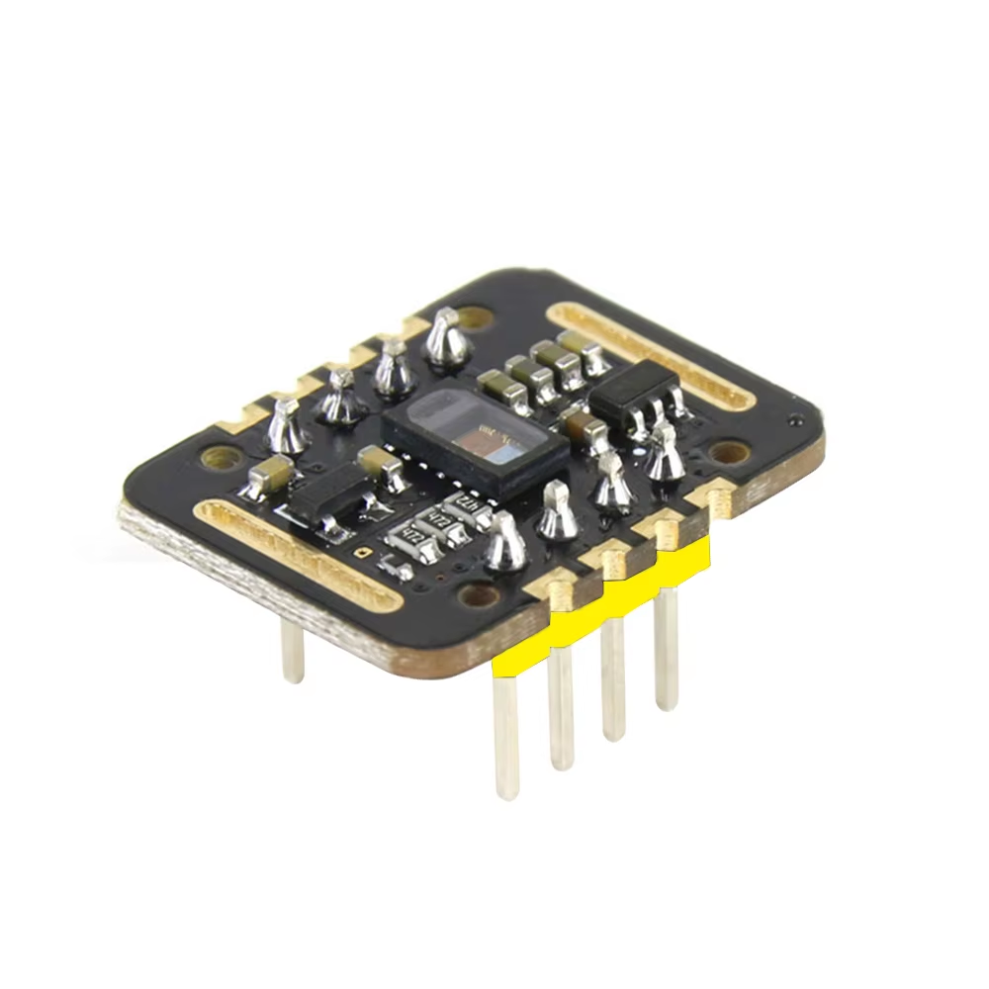


Hardware
Software
PPG Sensor - MAX30102
Raspberry Pi 5
Programming Language :
Python
Javascript
Library:
Max30102
Bluetooth
Chart.js

Slide 4
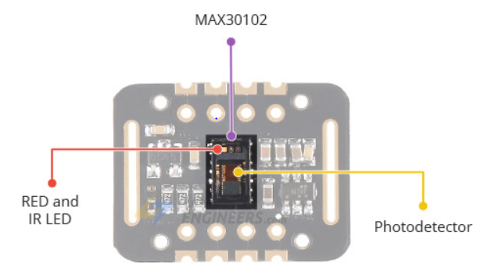
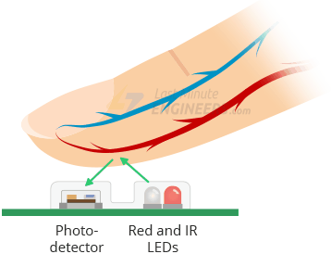
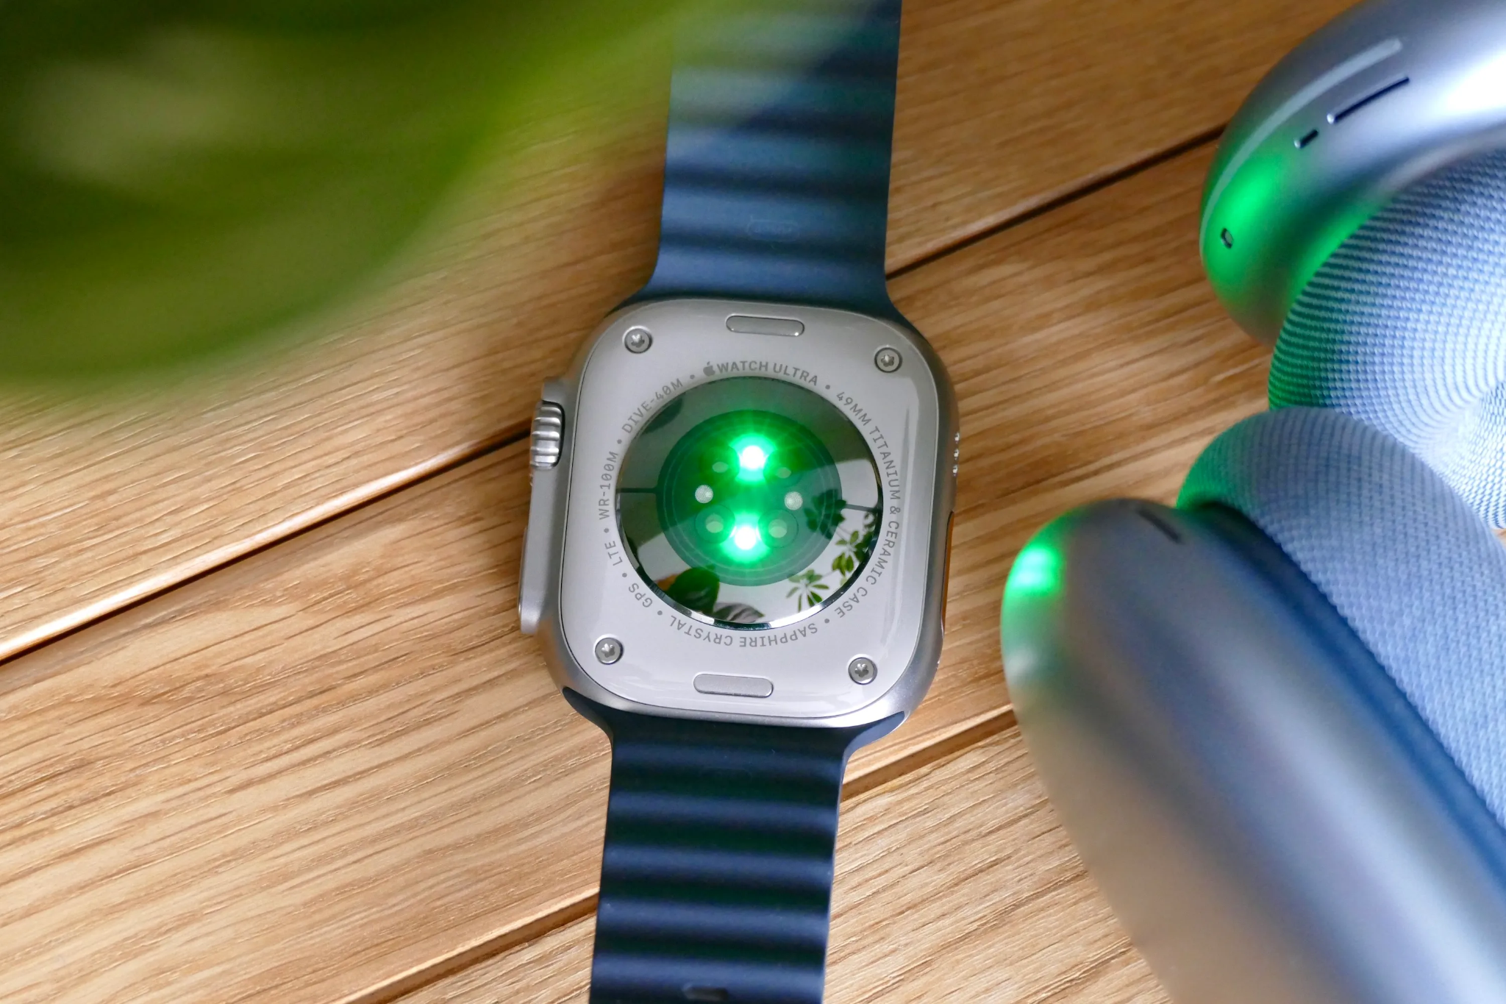
Photoplethysmography (PPG) sensor
Raw Sensor Data
Preprocessing
Peak detection
Heartbeat Calculation

Slide 5
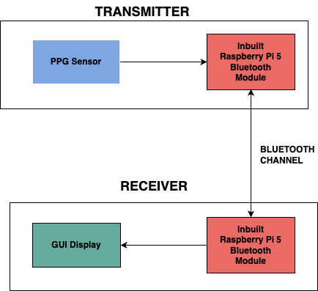
Flow

Slide 6
BLUETOOTH COMMUNICATION FLOW
Transmitter
Receiver
RASPBERRY PI 5
START_SYNC
RASPBERRY PI 5
ACK
ACK_OF_ACK
SENSOR DATA
STOP_SYNC
ACK
ACK_OF_ACK

Slide 7
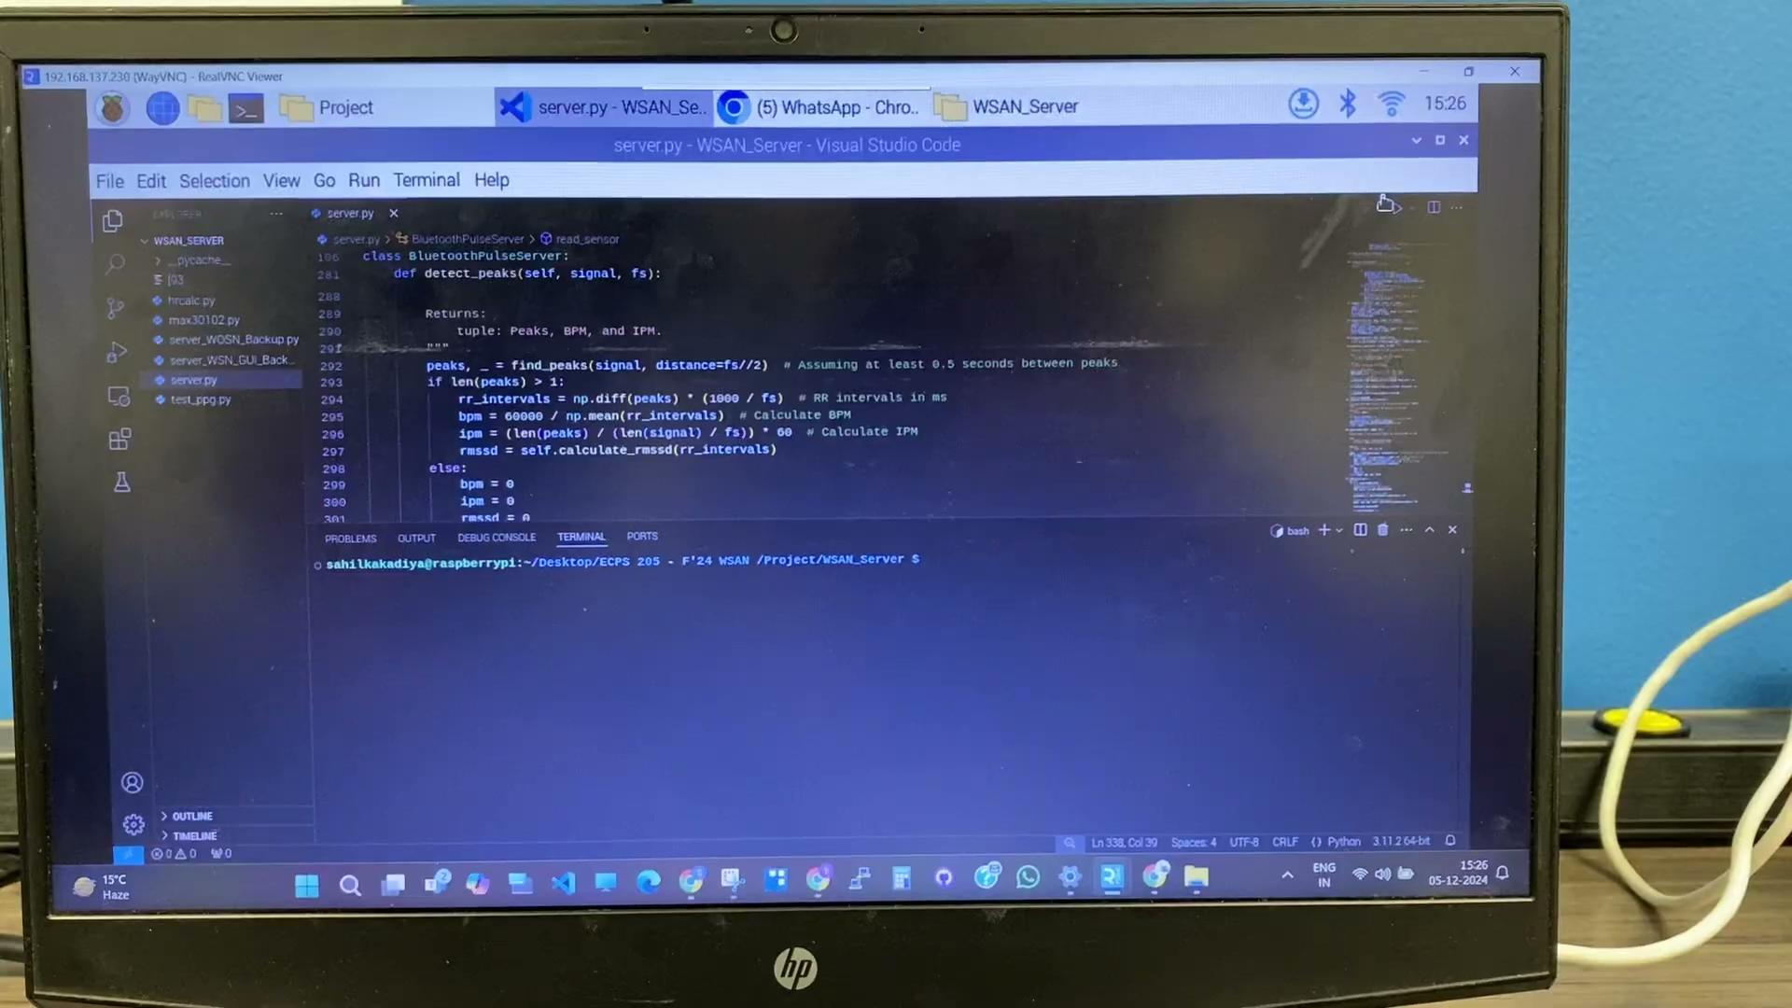
Demo Video Clip

Slide 8

Thank You!

